Slide 1
Advancing Solar Energy Best Practices in North Central Texas February 29, 2024

Slide 2
What We’ll Share Today
Welcome & Introductions
About SolSmart
Overview of Solar Best Practices
Upcoming NCTCOG Cohort Opportunity
Ask Us Anything

Slide 3
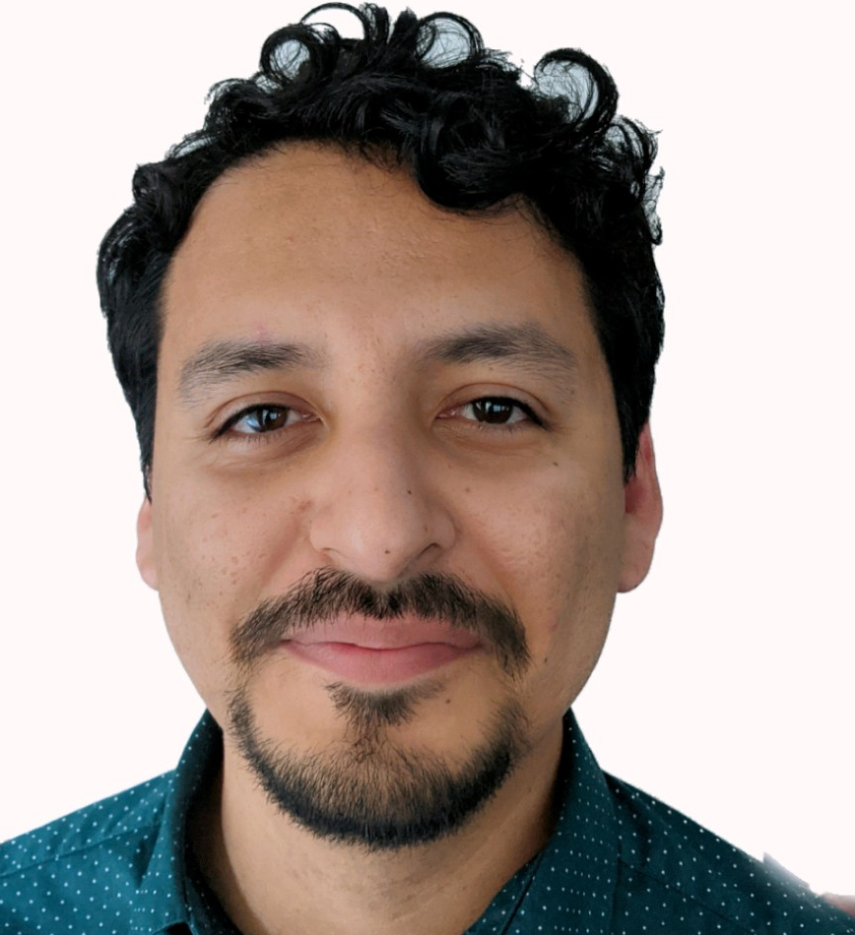
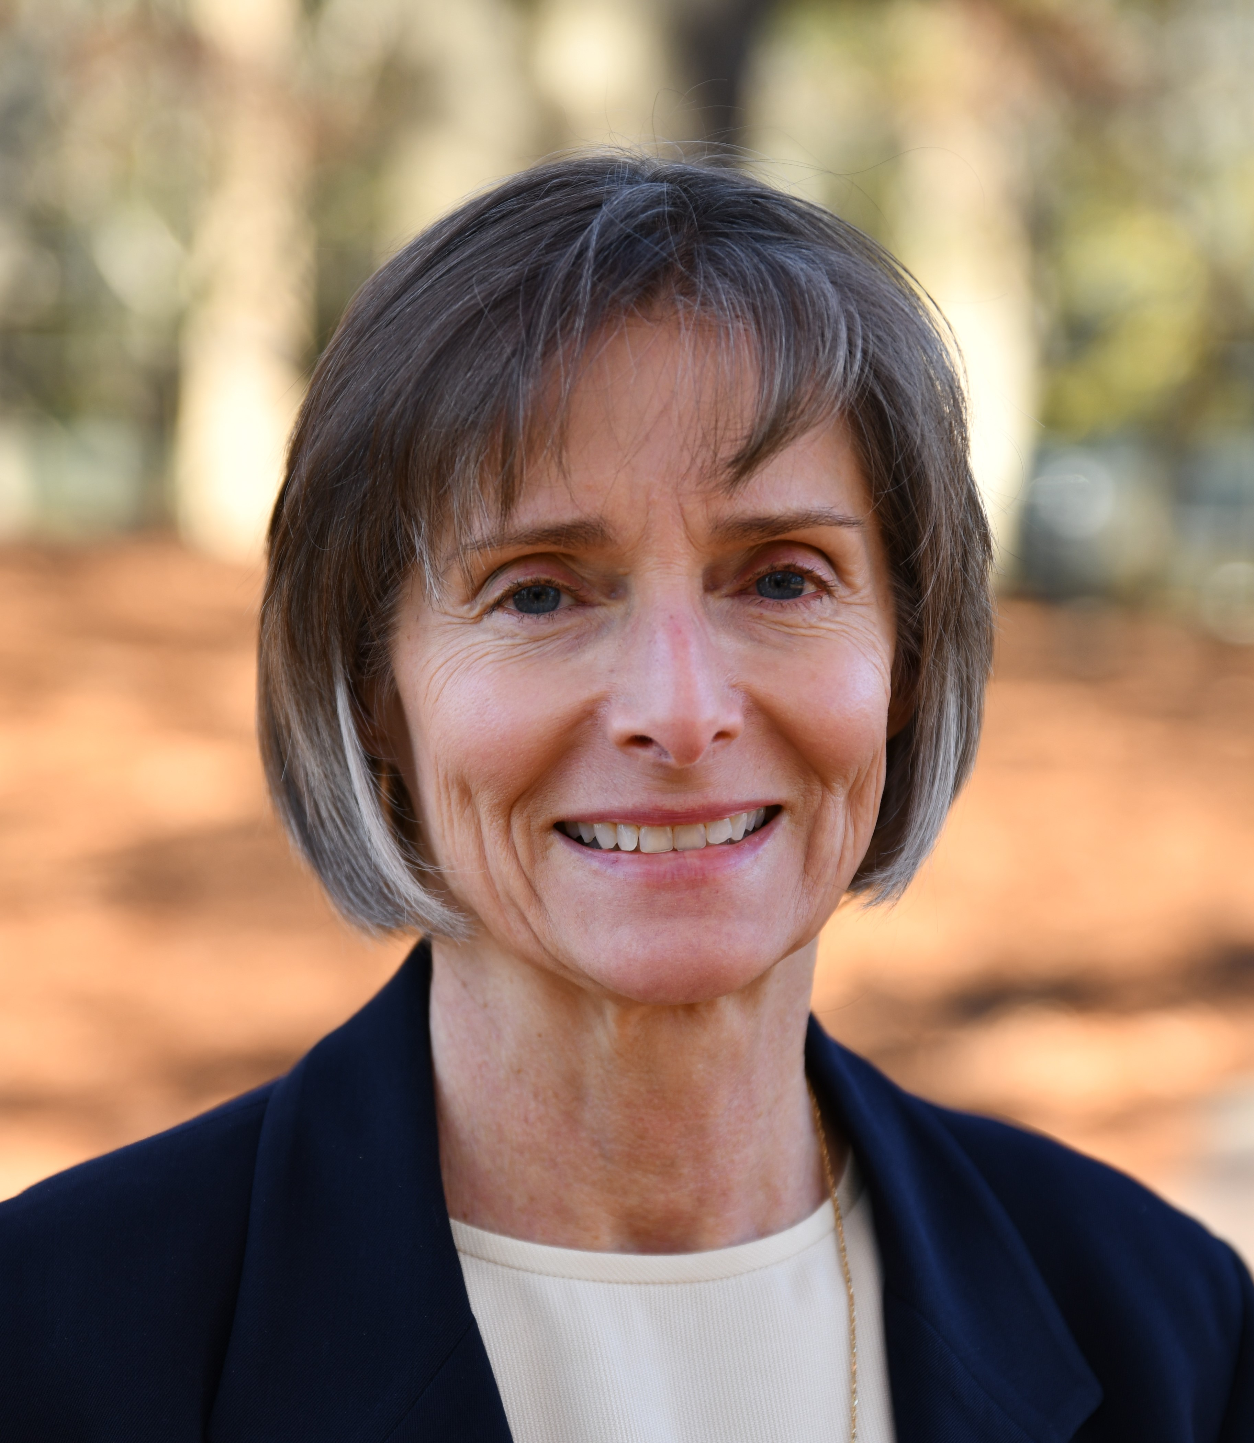
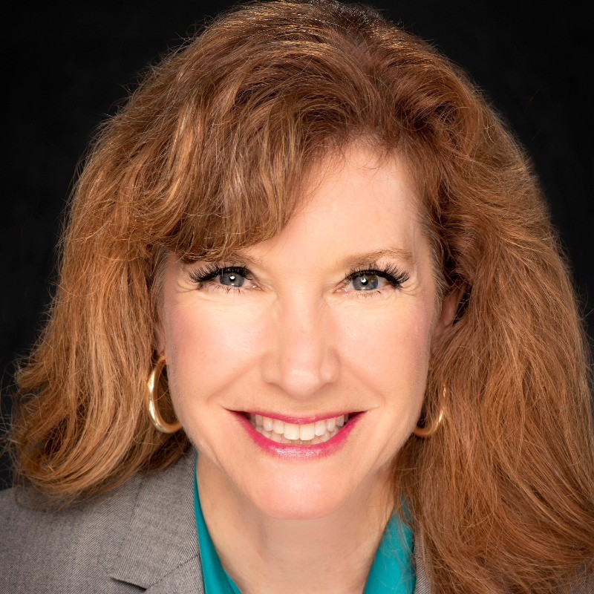
Who You’ll Hear From
Joaquin Escalante
Transportation Planner I
Dallas-Fort Worth Clean Cities
North Central Texas Council of Governments
(NCTCOG)
jescalante@nctcog.org
Alyssa Knox
Environment and Development Planner II, North Central Texas Council of Governments
(NCTCOG)
aknox@nctcog.org
Amy Hodges
Principal Transportation Planner
Dallas-Fort Worth Clean Cities
North Central Texas Council of Governments
(NCTCOG)
ahodges@nctcog.org
Brandy O’Quinn
Program Director, SolSmart
Interstate Renewable Energy Council (IREC)
brandyo@irecusa.org
Zach Greene
Senior Manager, Clean Energy
World Resources Institute (WRI)
zach.greene@wri.org

Slide 4
About SolSmart

Slide 5
Acknowledgement and Disclaimer
Acknowledgment: This material is based upon work supported by the Department of Energy, Office of Energy Efficiency and Renewable Energy (EERE), under Award Numbers DE-EE0009950 & DE-EE0009951.
Disclaimer: This report was prepared as an account of work sponsored by an agency of the United States Government. Neither the United States Government nor any agency thereof, nor any of their employees, makes any warranty, express or implied, or assumes any legal liability or responsibility for the accuracy, completeness, or usefulness of any information, apparatus, product, or process disclosed, or represents that its use would not infringe privately owned rights. Reference herein to any specific commercial product, process, or service by trade name, trademark, manufacturer, or otherwise does not necessarily constitute or imply its endorsement, recommendation, or favoring by the United States Government or any agency thereof. The views and opinions of authors expressed herein do not necessarily state or reflect those of the United States Government or any agency thereof.

Slide 6
About SolSmart
SolSmart Team
SolSmart is a national designation and technical assistance program funded by the U.S. Department of Energy's Solar Energy Technologies Office (SETO) to help local governments nationwide make it faster, easier, and more affordable for residents and businesses to go solar.
A SolSmart designation recognizes communities that have taken key steps to address local barriers to solar energy and foster the growth of mature local solar markets. It demonstrates that a community is “open for solar business,” making it attractive to solar companies and other business development.

Slide 7
SolSmart’s Role in Solar Deployment
SolSmart helps local governments take action to remove barriers to solar energy growth and make it easier for residents and businesses to go solar
The program offers no-cost technical assistance and resources that help communities become national solar energy leaders
SolSmart is committed to meeting the goals of the federal Justice40 program to provide equitable opportunities for underserved communities
SolSmart helps communities reduce “soft costs” — the costs of solar development that are unrelated to hardware
“Soft costs” represent 65% of the total cost of a solar PV system and they arise from:
Permitting and inspection processes;
Zoning and design requirements
Customer acquisition;
Gaps in financing; and more!

Slide 8
SolSmart’s Role in Solar Deployment
Helps local governments:
1.
Removes Barriers for Solar
2.
Free Technical Assistance & Resources
3.
Reduces solar
“soft costs”

Slide 9
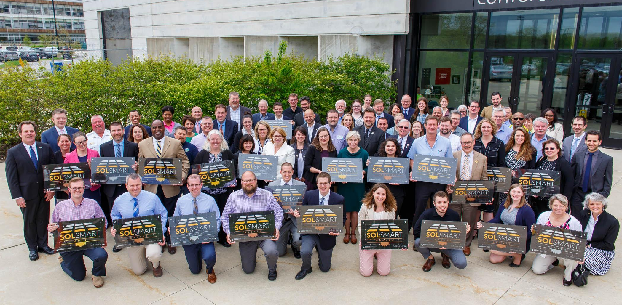
SolSmart: A Roadmap to Advance Solar Locally
Five “Solar-Ready” Categories
Permitting & Inspection
Market Development
Planning & Zoning
Community Engagement
Government Operations
23 Chicago-area cities, towns, and counties awarded SolSmart designations at Argonne National Lab in 2019
Notes:
Permitting & Inspection and Planning & Zoning are the bedrock of a solar-ready community, upon which everything else can be built upon.
Bolded are specific criteria or actions that a local government can take to become more ready for solar
The other three categories: Government Operations, Community Engagement, and Market Development are going an extra step to enable and encourage local solar.
Local governments are also employers, landlords, educators, and consumers, which means they are in a unique position to lead by example. Their influence and impact reach beyond the role of serving as a governing body.
In total there are 92 unique actions and each are worth 5 to 20 points based on how impactful they are.
Now let’s dive into some specific actions and criteria from the program

Slide 10
Designation Structure
Four levels of designation:

Slide 11
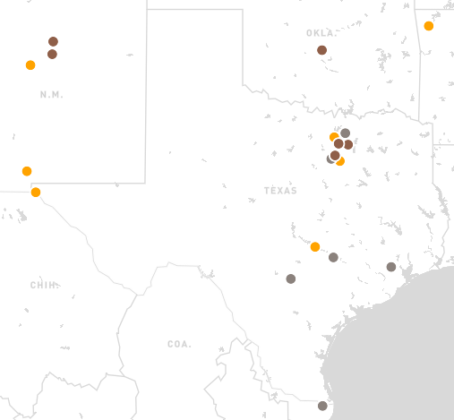
SolSmart By the Numbers
Active in communities across the country:
43 states + District of Columbia, Puerto Rico, U.S. Virgin Islands
117 million people (over 1 in 3 U.S. residents)
SolSmart in TX
1
193
513
137
182
3
6
5

Slide 12
Technical Assistance Examples
Planning and zoning
Feasibility assessments
Permitting and inspection
Policy and market expertise
Procurement
Financing
Solar PV system design
Stakeholder Engagement
Notes:
So across the SolSmart team we have quite a few organizations all housing specialized knowledge and expertise needed to remove barriers in categories including the following. We can tap in to a lot of different resources to support Tempe in a specialized way across your goals – for FREE, paid for by the DOE

Slide 13
Best Practice Resources & Customized Support
The SolSmart Program Guides summarize best practices for local governments, counties and regional governments.
Technical Assistance is tailored around the goals and priorities of your community. It can include expert review of materials, webinars, trainings​ and 1:1 consultations.
Notes:
It’s tailored to your community. This can be phone calls, zoom meetings, trainings, supplying templates or model code. It’s really up to you

Slide 14
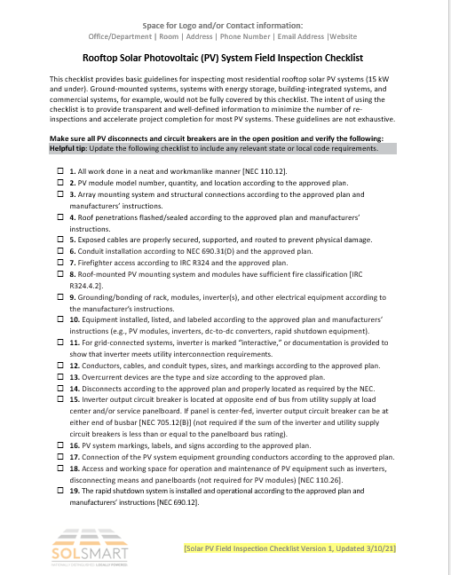
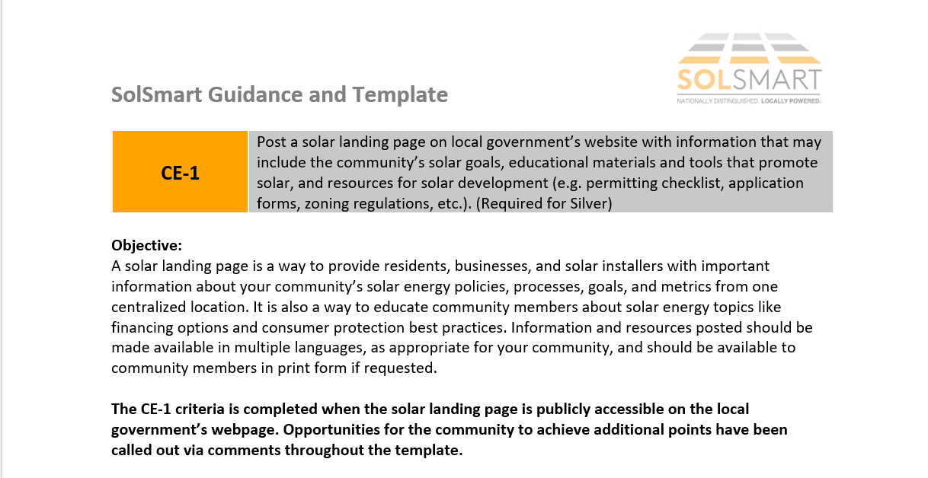
Templates and Examples
Communities are provided with templates, checklists, community examples and guidance documents.
Notes:
On the SolSmart.org website today, already available to you are tons of templates and examples.

Slide 15
Overview of Solar Best Practices

Slide 16
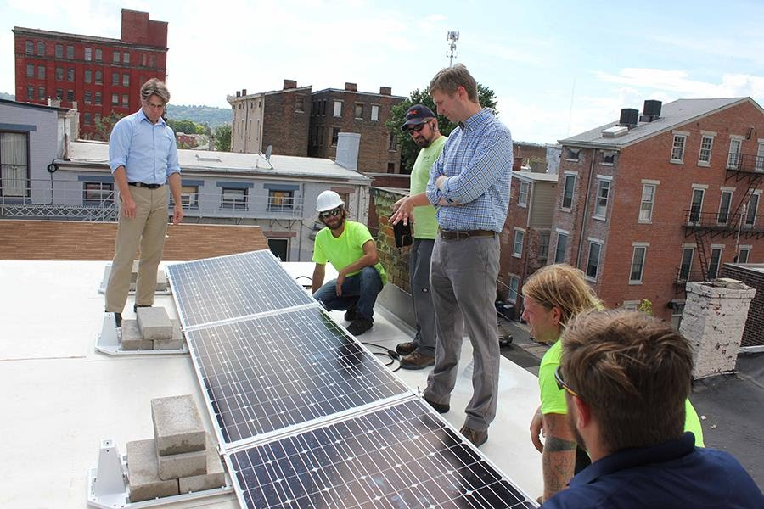
Permitting & Inspection Category
28 criteria including:
Post solar field inspection requirements online, detailing the inspection process and what inspectors will review
(10 points)
Post a solar permitting checklist online
(Pre-requisite, 0 points)
Post solar field inspection requirements or checklist online, detailing the inspection process and what inspectors will review (10 points)
Demonstrate pathway for instant/automatic approval of residential rooftop solar PV systems (e.g., SolarAPP+) (20 points)
Source: Greater Cincinnati Energy Alliance

Slide 17
Kennedale, TX (SolSmart Silver)
Solar-Panel Application (cityofkennedale.com)
Notes:
This is an example of online permitting checklist. A straightforward way to accelerate permit approval timelines and save staff time by reducing inquiries from installers, requests for additional information, and incomplete permit applications. You’d be surprised by how often local governments don’t explicitly state what’s needed creating needless back and forth that rack up more staff time and other soft costs.

Slide 18
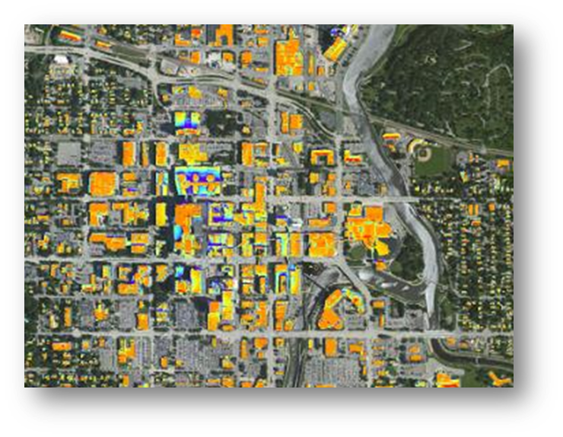
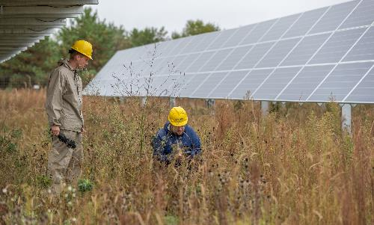
Planning & Zoning Category
26 criteria including:
Establish specific solar PV goals, metrics, and strategies in the most current local government plans
(10 points)
Review zoning code to identify restrictions that prohibit solar PV.
(Pre-requisite, 0 points)
Codify that rooftop solar PV is explicitly allowed “by-right” in all major zones (10 points)
Ensure that large-scale solar PV can be “co-located” with agricultural uses such as grazing, apiaries, or crops (agrivoltaics) (5 points)

Slide 19
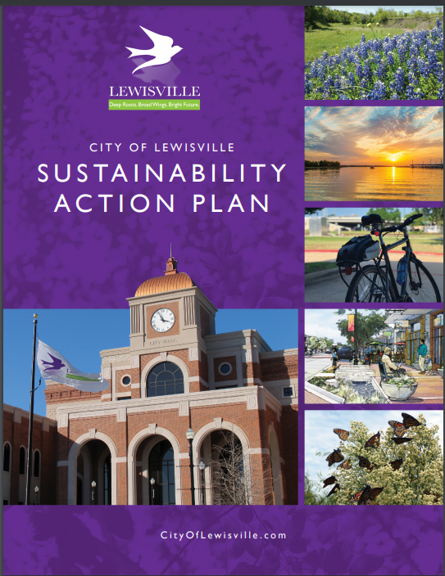
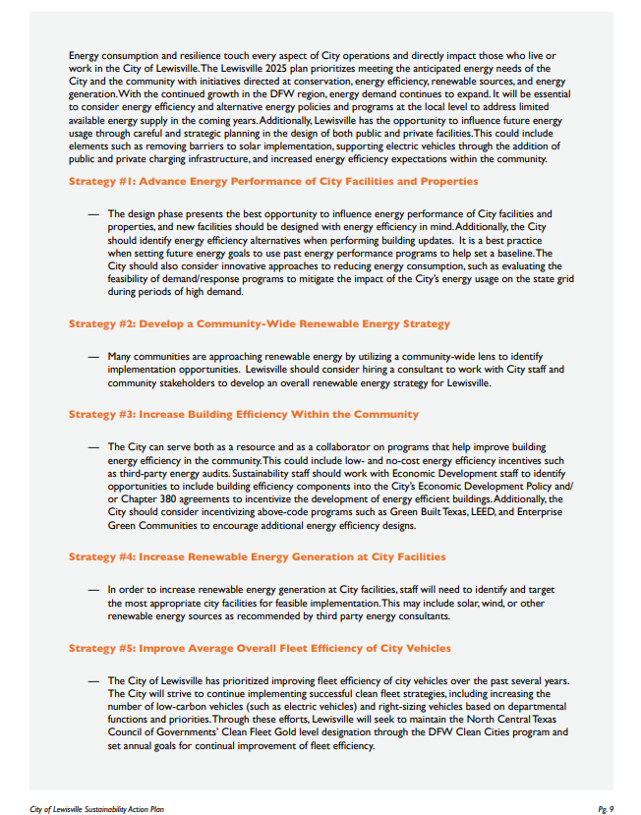
Lewisville, TX (SolSmart Bronze)

Slide 20
Government Operations Category
14 criteria including:
Coordinate with regional orgs and/or local governments to engage utilities on advancing solar policies such as…
(10 points)
Install solar on local government facility or controlled land
(Pre-requisite, 20 points)
Procure solar energy for municipal operations through an offsite physical PPA, virtual PPA, green tariff or similar structure (10 points)
Discuss community goals for solar PV, net metering, community solar, and/or interconnection processes with the local utility and explore areas for future collaboration (10 points)
Credit: RMI

Slide 21
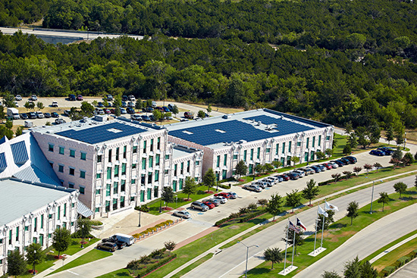
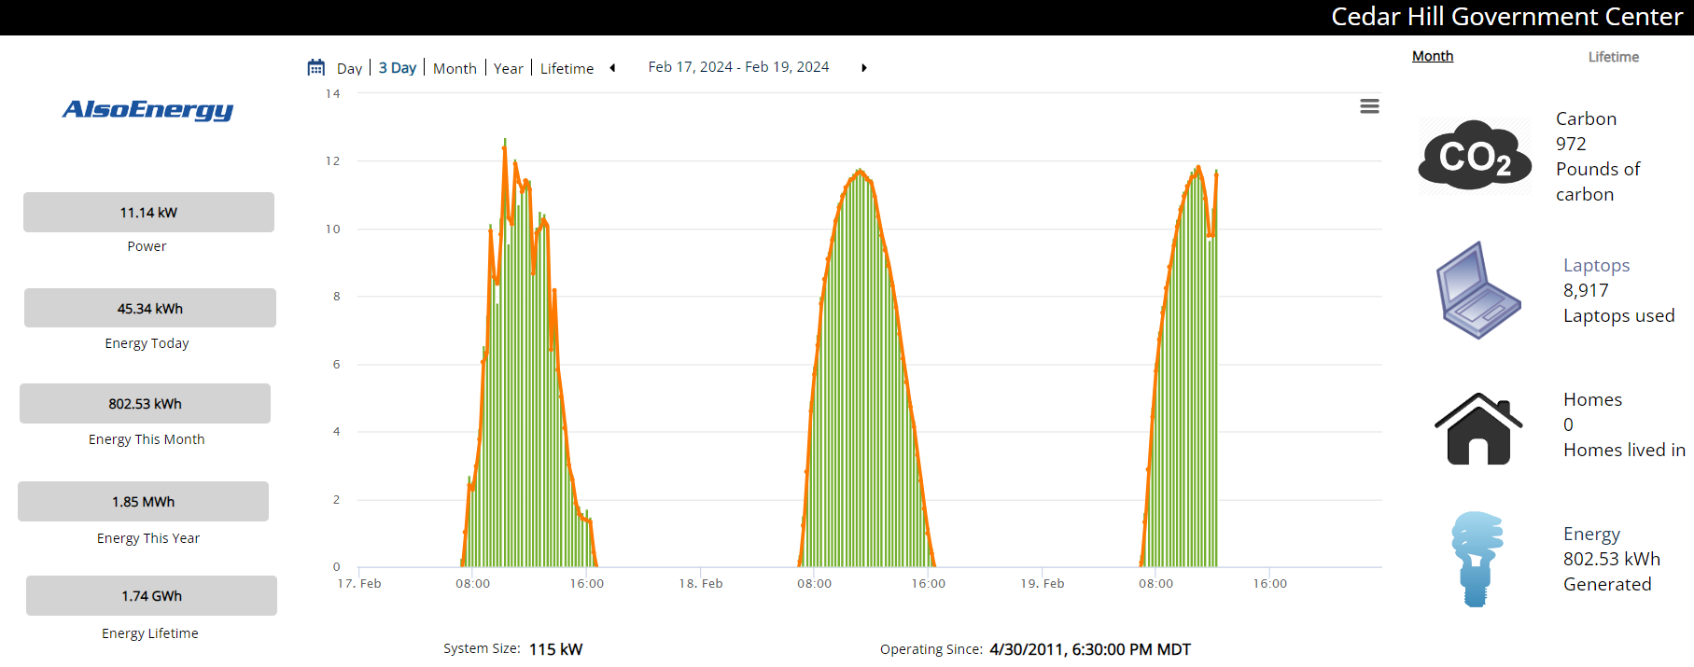
Cedar Hill, TX (SolSmart Gold)

Slide 22
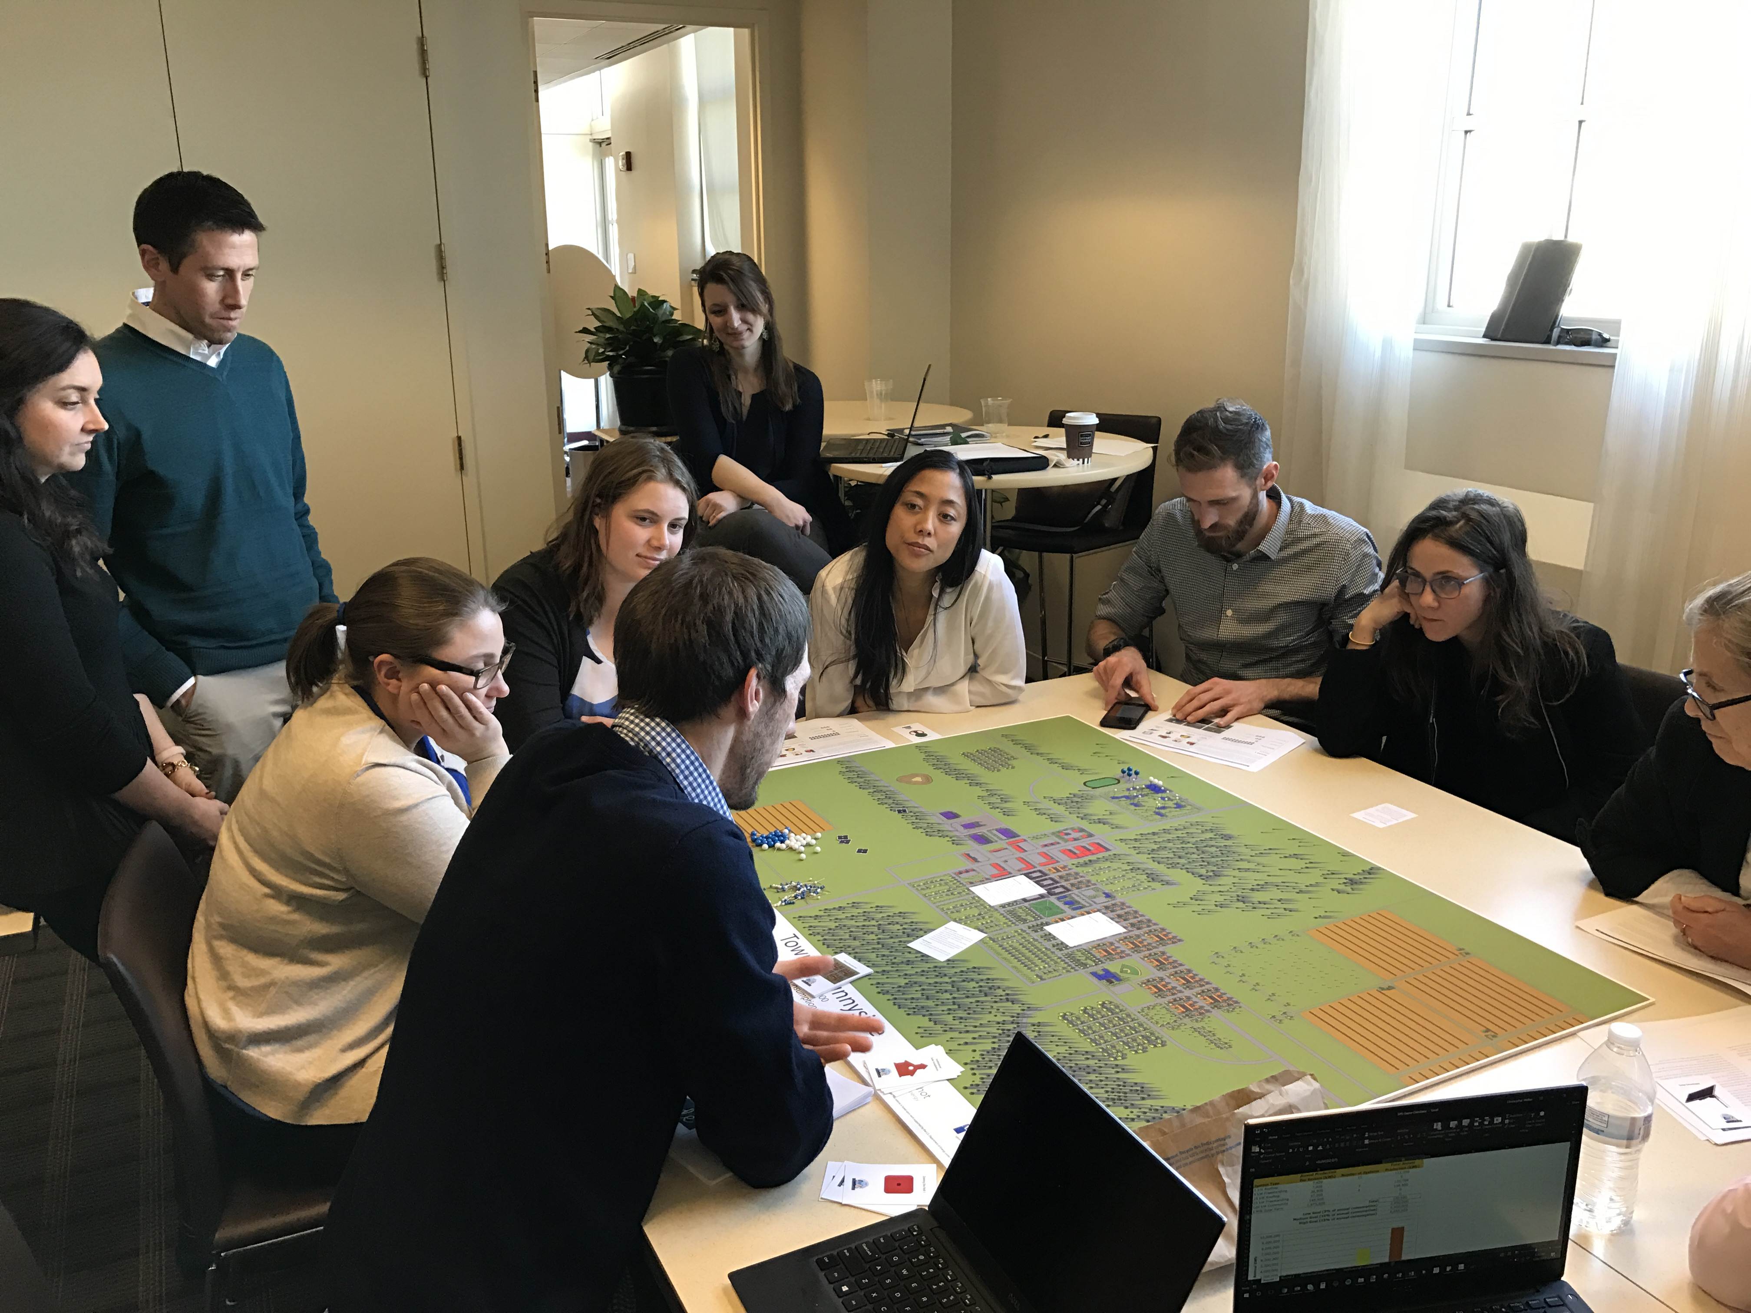
Community Engagement Category
13 criteria including:
Distribute solar job training and career opportunities in coordination with local colleges and/or workforce development orgs (5 points)
Post a solar landing page on local government’s website with information that may include the community’s solar goals, educational materials and tools that promote solar
(Pre-requisite, 10 points)
Establish partnerships with local CBOs to define your community’s solar equity goals, develop implementation strategies, and establish a plan for tracking and reporting on progress (20 points)
Support a solar information session and/or solar tour (10 points)

Slide 23
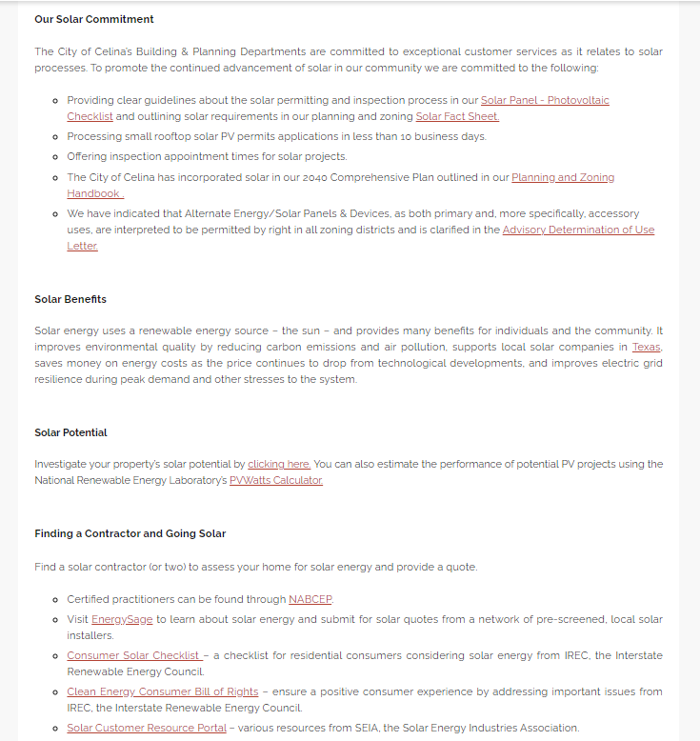
Celina, TX (SolSmart Gold)

Slide 24
Market Development Category
10 criteria including:
Partner with financial institutions and/or foundations to offer loans, rebates, grants, or other incentives for solar PV projects (20 points)
Support a solarize or solar co-op campaign (20 points)
Support a community solar program (20 points)
Provide local incentives or locally-enabled finance (e.g., a revolving loan fund) for solar PV and/or solar PV + technologies (e.g., battery storage and/or electric vehicle charging) (20 points)

Slide 25
Plano, TX (SolSmart Bronze)
“The City of Plano supports and applauds Solar United Neighbors for facilitating the Plano Solar Co-Op. Not only do co-op members learn about solar energy, they leverage their participation numbers to get competitive pricing and quality solar installations. SUN works closely with the co-op members every step along the process to ensure the members are supported and have guidance.”
- Heather Harrington, Plano’s sustainability and environmental education supervisor
Sources: https://www.solarunitedneighbors.org/co-ops/texas/plano-solar-co-op-2/; https://rmi.org/bringing-solar-power-to-the-people/; https://planomagazine.com/plano-solar-coop/

Slide 26
Questions on SolSmart

Slide 27
Upcoming NCTCOG Cohort Opportunity

Slide 28
NCTCOG is launching a new cohort for communities to achieve SolSmart designation
What is a cohort?
A "cohort" is a series of workshops that leverage peer dialogues and education from subject matter experts to help participants better understand and/or act on an issue.
What are the key objectives?
To deliver education and support local action on adopting solar best practices.
To enable peers from across local governments to engage with one another, and with subject matter experts.
To support participating local governments in achieving their desired tier of designation.
Who can participate?
Any local government within the NCTCOG region that is seeking initial designation or wants to level-up to a higher tier of designation.

Slide 29
Cohort Structure & Timeline
March 2024
Session #1: Setting the stage for solar development
Session 2: Planning for solar
Best practice guidance for planning and zoning of small and large-scale solar arrays
Session 3: Permitting & inspection for solar
Session 4: Community engagement & municipal operations
Guidance on how to support residents, businesses, and your own operations teams as they consider adopting solar
June 2024
April 2024
May 2024
Overview of regional and state energy context
Training on best practices for permitting and inspecting solar arrays
July 2024
Session 5: Wrap up & next steps
Address any outstanding questions and chart a pathway forward
Access to 1-on-1 technical assistance support

Slide 30
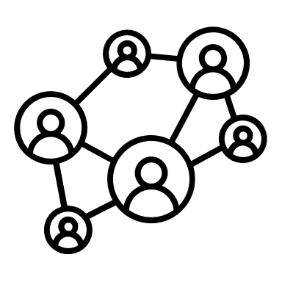
Why Participate in the Cohort?
Gain a deeper understanding of solar best practices and emerging issues, such as federal funding opportunities
Work through the SolSmart program in an expedited way with a curated session structure and pathway to designation
Connect with your peers from other local governments in the region to hear about their efforts, successes, and lessons learned
Earn a nationally recognized designation from the U.S. Department of Energy and other media acknowledgement

Slide 31
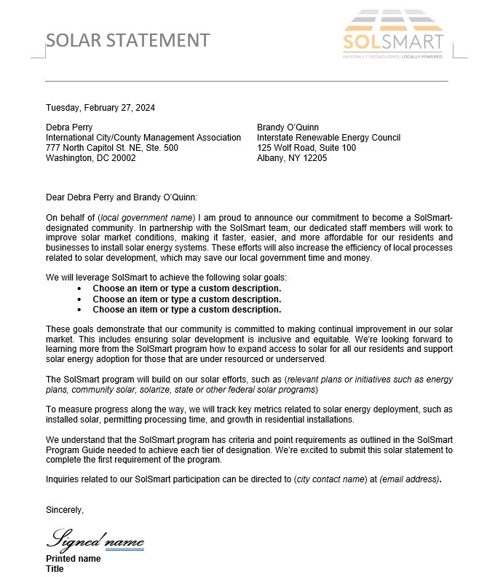
Next Steps for Communities Interested in Participating in the Cohort
A "Solar Statement" (PR-1) is a letter that demonstrates your local government's commitment to pursuing SolSmart designation.
All communities receiving technical assistance must submit a Solar Statement, and it's a prerequisite for designation at any tier.
A Solar Statement is not a binding agreement, a memorandum of understanding or any other kind of legal document.
The Solar Statement should be signed by a department head or an elected official, or it can go through a council approval process.

Slide 32
Next Steps for Communities Interested in Participating in the Cohort
Discuss the opportunity with your team and community leadership.
Engage with permitting/inspection and planning/zoning staff who will need to attend sessions.
Commit to the cohort by submitting a “Solar Statement” (or by sending an email) to Joaquin Escalante (energy@nctcog.org) and Zach Greene (zach.greene@wri.org) by Friday, March 22.
- Share the name(s) and contact information of other participating staff, too, so they
can be included in relevant outreach and calendar invitations.
The SolSmart team will use public information to conduct a baseline analysis of your community’s solar efforts to date and zoning ordinance, and the results will be shared before the second cohort session.
If you have any questions or near-term technical assistance needs, please send an email copying both Joaquin Escalante (energy@nctcog.org) and Zach Greene (zach.greene@wri.org)
Notes:
An example of this is the City of Orlando, Florida. They partnered with a local non-profit, Solar and Energy Loan Fund, to make solar and other sustainable home improvements more affordable and accessible to underserved communities by providing innovative financing options. This is a really cool example of them really taking a big step forward to support their residents

Slide 33
Ask Us Anything
Notes:
Introduce self
Helping local governments to become “Solar Ready”

Slide 34
Thank You!
Notes:
Introduce self
Helping local governments to become “Solar Ready”

